Slide 1

Deep Learning 101
MORE THAN A SEMINAR

Slide 2

Part 1 Firstly …
Part 2 Chapter 1
CONTENT
Part 3 Chapter 2
Part 4 About Me
Part 5 About Seminar

Slide 3
Part 1
Firstly…
How to impress you?

Slide 4
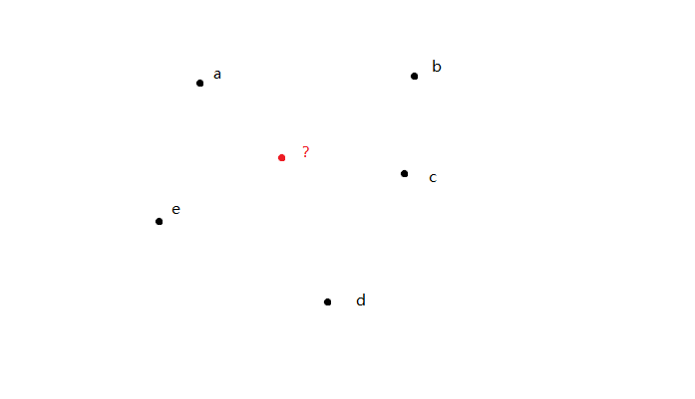
Problem 1
Where to build the hospital?

Slide 5
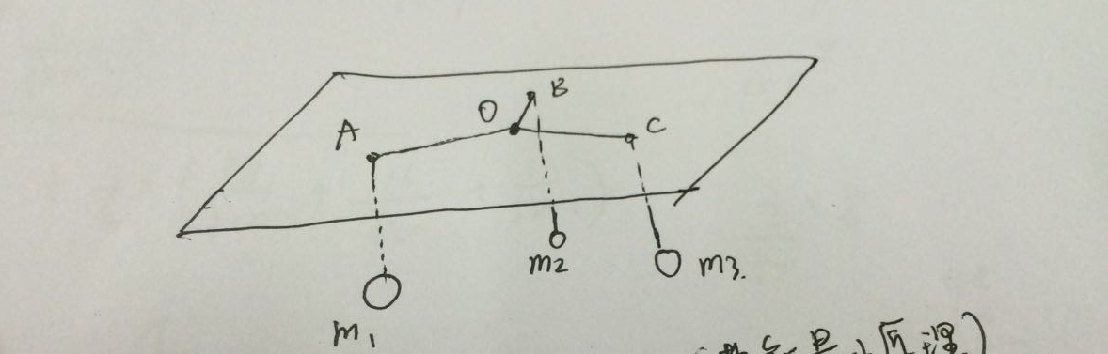
Problem 1
Principle of minimum potential energy

Slide 6
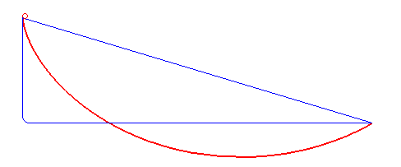
Problem 2
How to calculate the curve ?

Slide 7
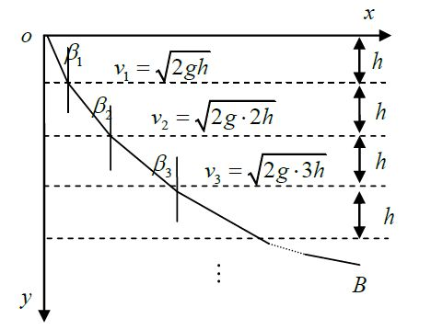
Problem 2
Fermat principle

Slide 8
In my opinion…
Neural Network
Originally generated from nature.
Simple but work.

Slide 9
Part 2
Chapter 1
Introduction

Slide 10
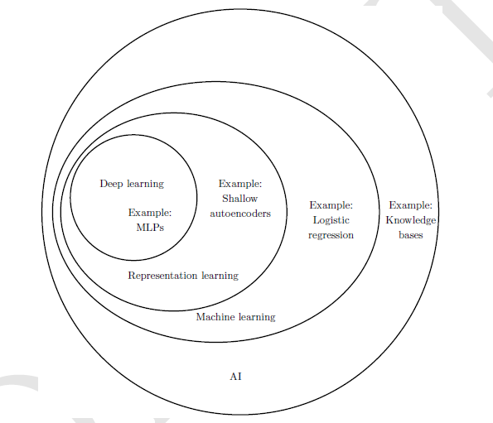
About AI
From the perspective of feature…

Slide 11
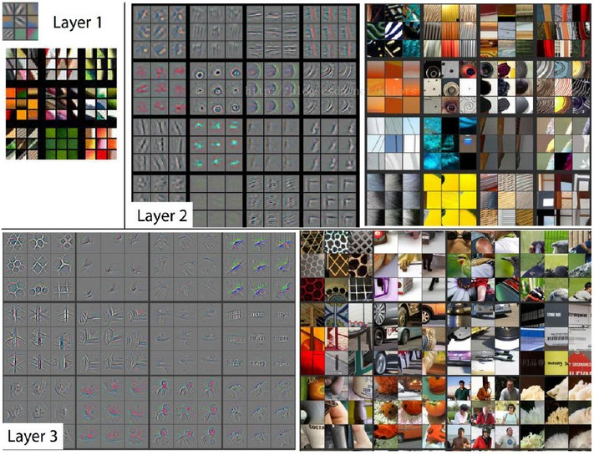

About AI
DeConv
Zeiler, Matthew D., and Rob Fergus. "Visualizing and understanding convolutional networks." European conference on computer vision. Springer International Publishing, 2014.

Slide 12
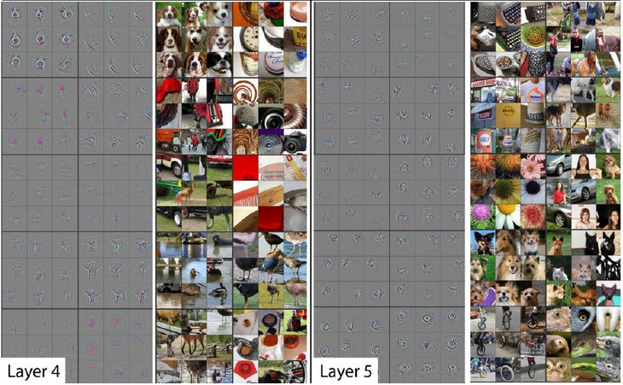
About AI
DeConv
Zeiler, Matthew D., and Rob Fergus. "Visualizing and understanding convolutional networks." European conference on computer vision. Springer International Publishing, 2014.

Slide 13
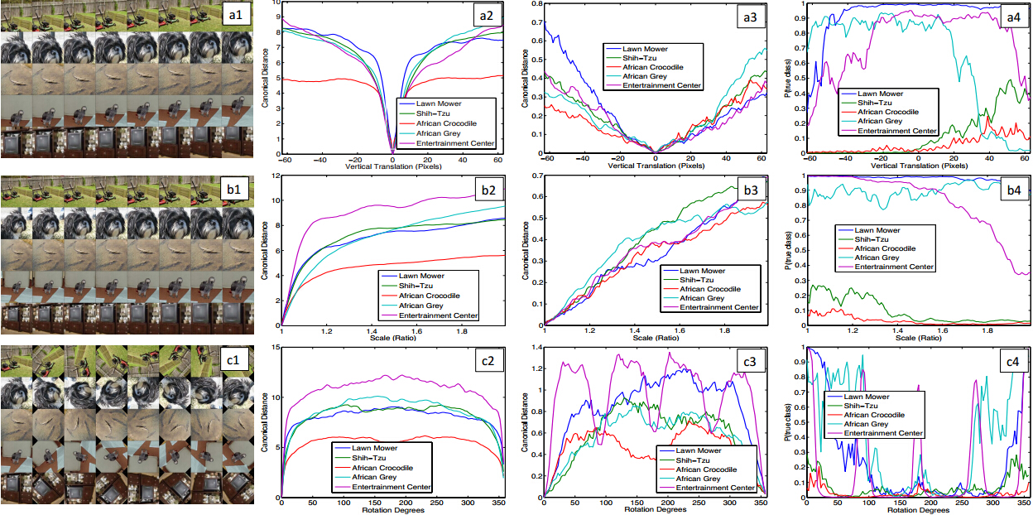
About AI
Zeiler, Matthew D., and Rob Fergus. "Visualizing and understanding convolutional networks." European conference on computer vision. Springer International Publishing, 2014.

Slide 14
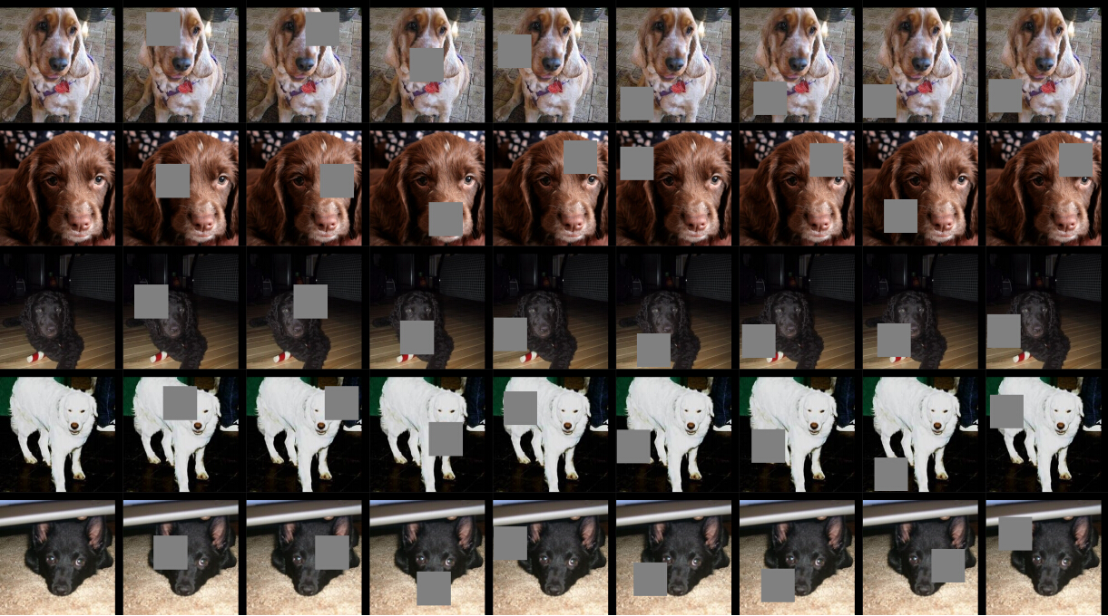
About AI
Zeiler, Matthew D., and Rob Fergus. "Visualizing and understanding convolutional networks." European conference on computer vision. Springer International Publishing, 2014.

Slide 15
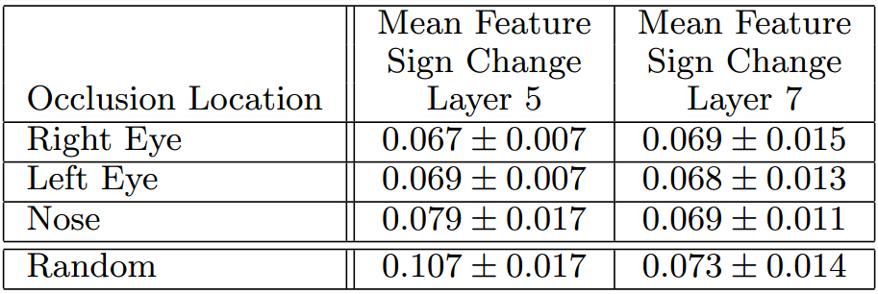
About AI
Zeiler, Matthew D., and Rob Fergus. "Visualizing and understanding convolutional networks." European conference on computer vision. Springer International Publishing, 2014.

Slide 16
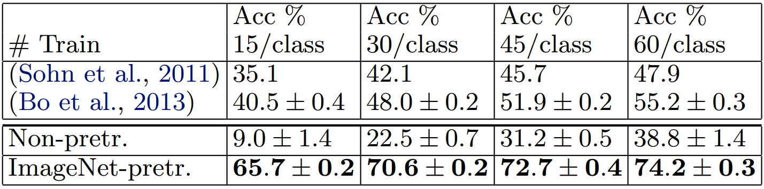
About AI
Zeiler, Matthew D., and Rob Fergus. "Visualizing and understanding convolutional networks." European conference on computer vision. Springer International Publishing, 2014.

Slide 17
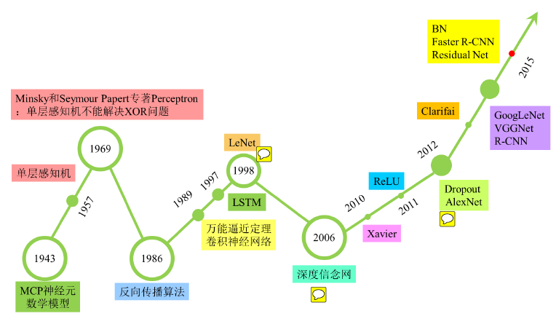
About Deep Learning
History

Slide 18
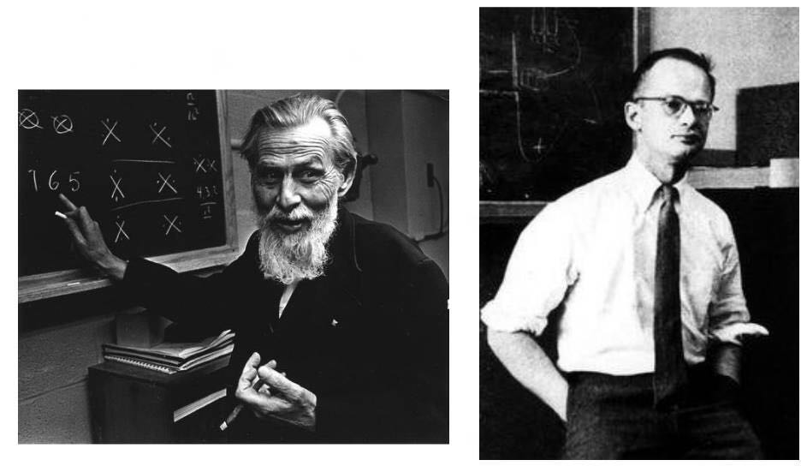
1943 MP
W.S.McCulloch & W.Pitts

Slide 19
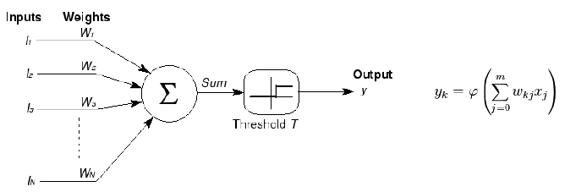
1943 MP

Slide 20
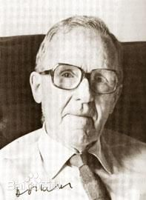
1949
Donald Hebb

Slide 21
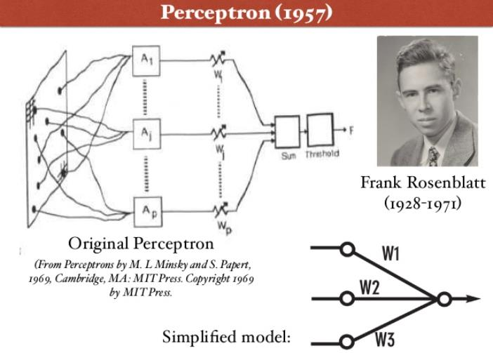
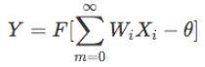
1957 Perceptron
Electronic ‘Brain’ Teaches Itself

Slide 22
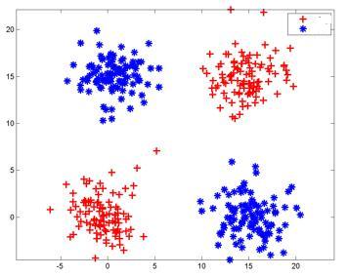
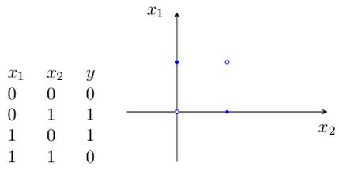
problem

Slide 23
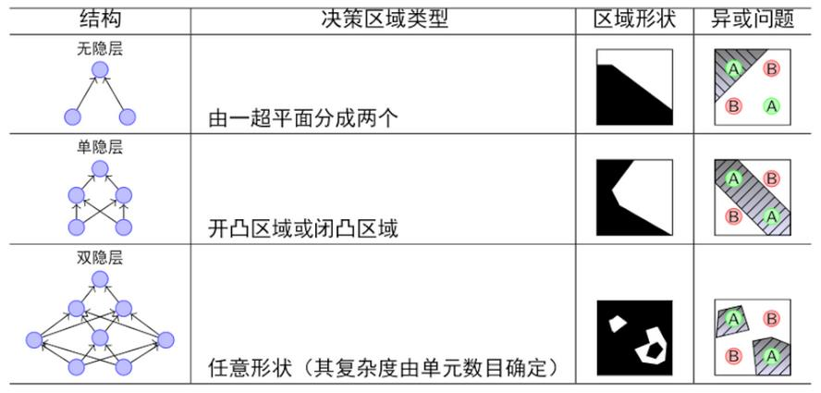
problem
Multi-Perceptron

Slide 24
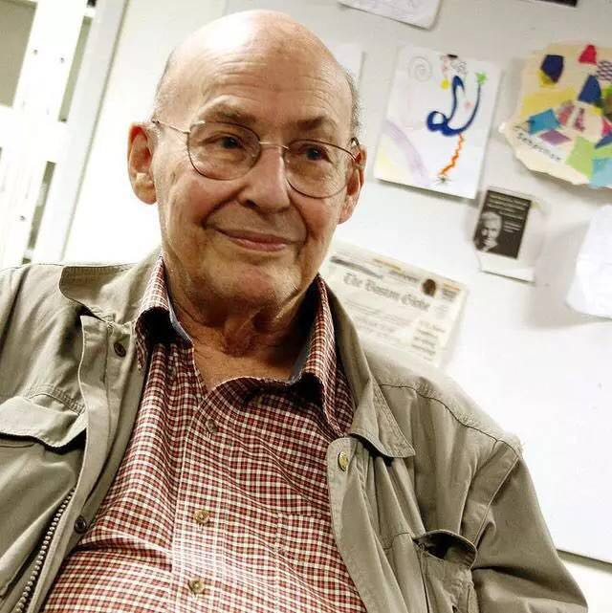
1969
Marvin Minsky

Slide 25
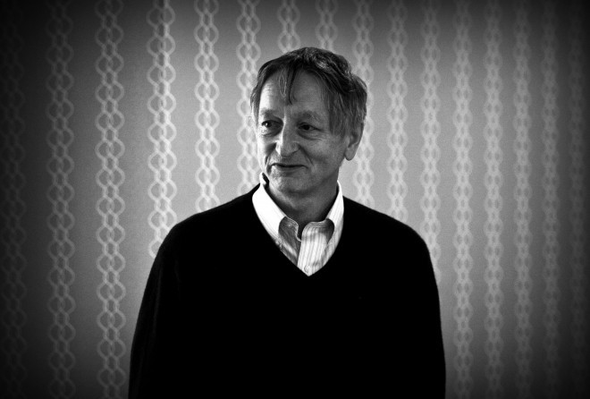
1986 BP
Geoffrey Hinton

Slide 26
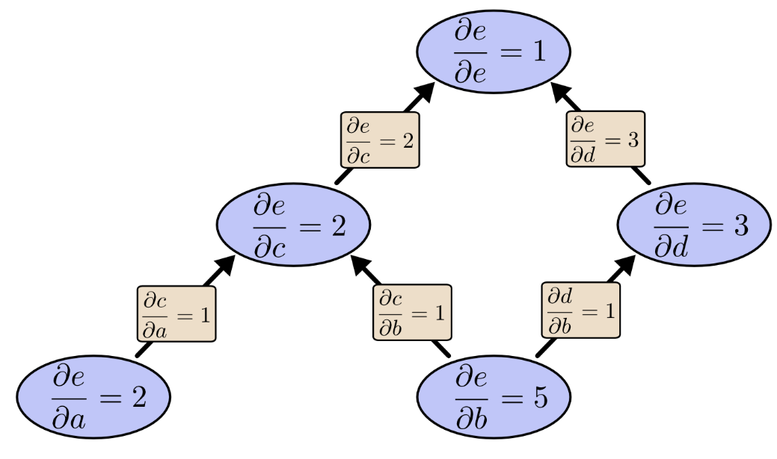
1986 BP
https://colah.github.io

Slide 27
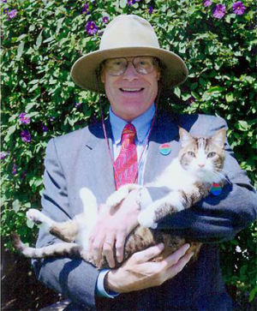
1989 principle of MLP
Robert Hecht-Nielsen

Slide 28
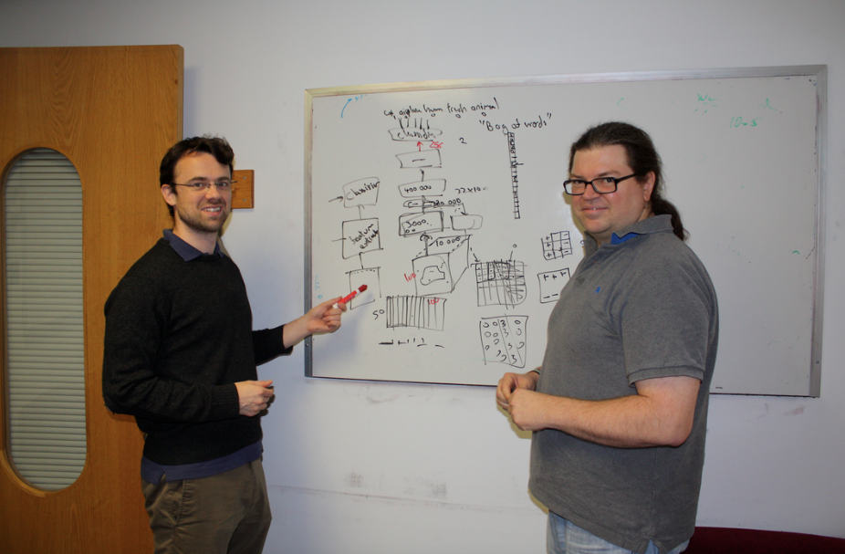
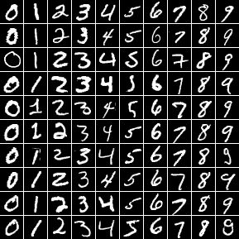
1989 LeNet
Yann LeCun
MNIST

Slide 29
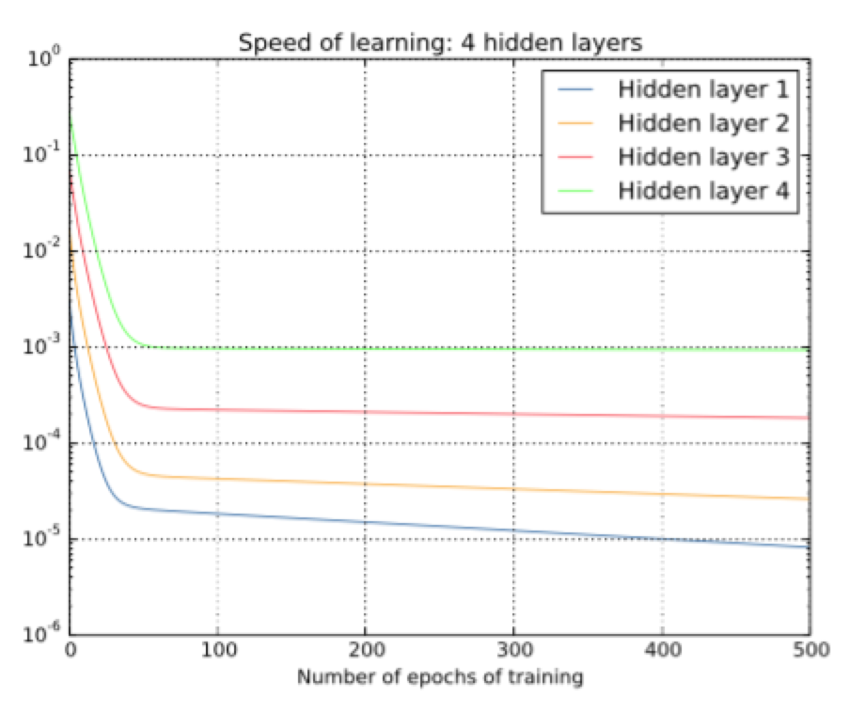
1991 Vanishing Gradient

Slide 30

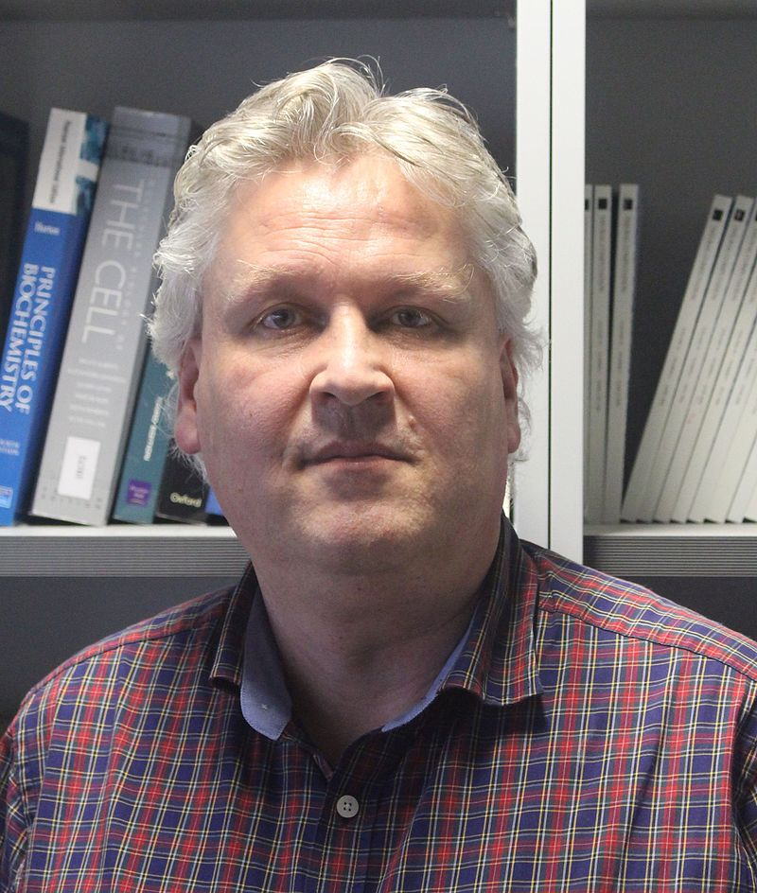
1997 LSTM
Hochreiter & Schmidhuber

Slide 31

1997 LSTM

Slide 32
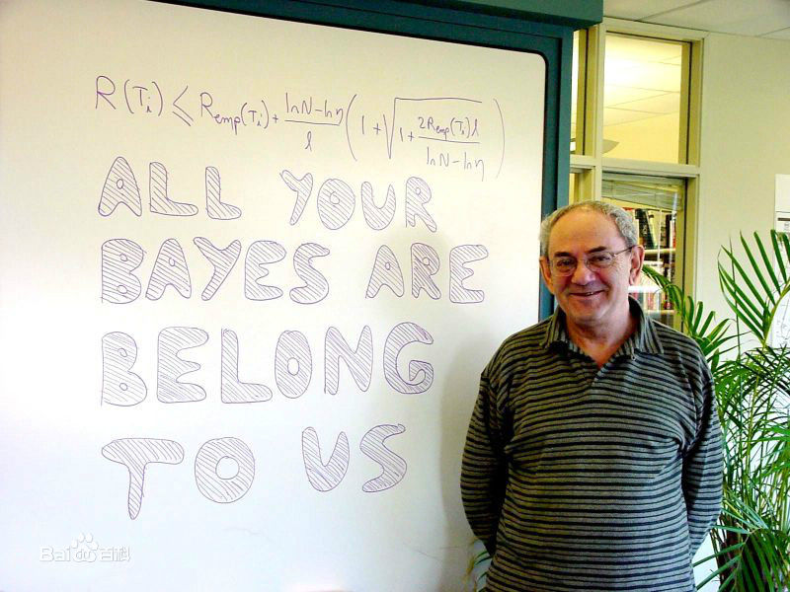
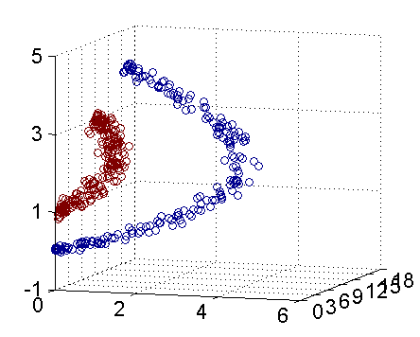
1986-2006 Statistical Learning
Vapnik
Pluskid.org

Slide 33
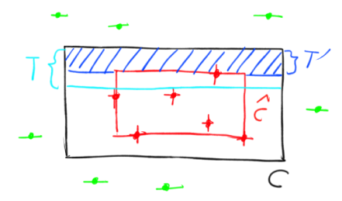
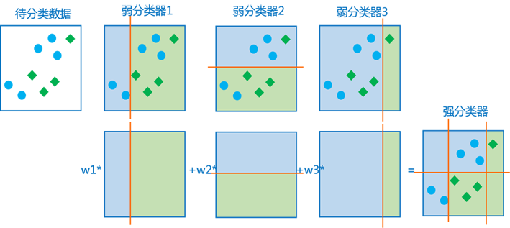
1986-2006 Statistical Learning
PAC learning
boosting

Slide 34
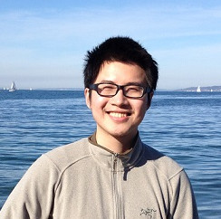

1986-2006 Statistical Learning
Tianqi Chen
kaggle

Slide 35
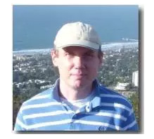
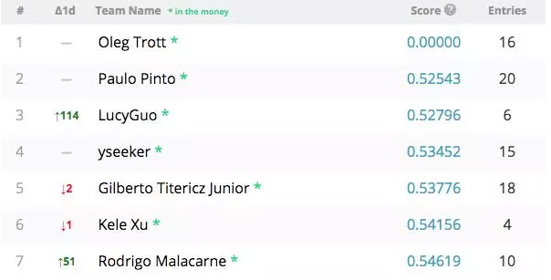
1986-2006 Statistical Learning
Oleg Trott
Data leak

Slide 36
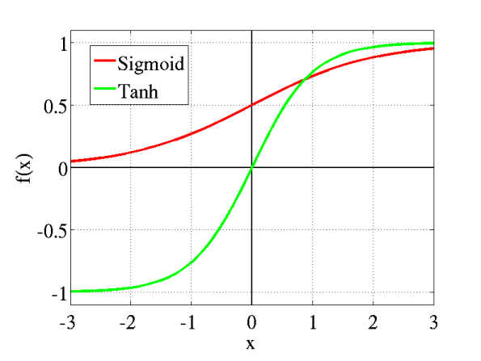
2011 relu

Slide 37
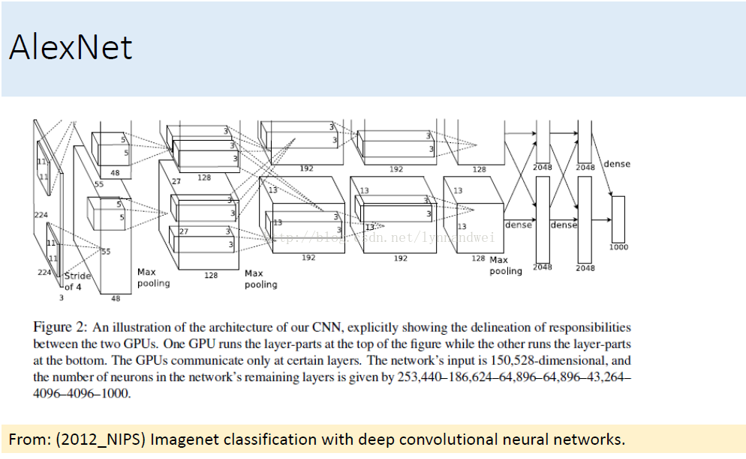
2012 AlexNet
Alex Krizhevsky、Ilya Sutskever

Slide 38
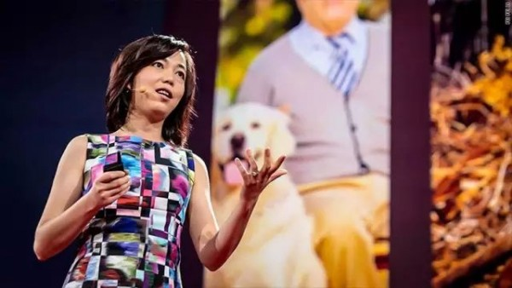
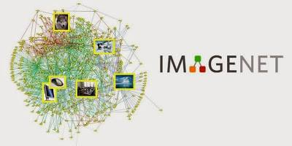
ImageNet

Slide 39
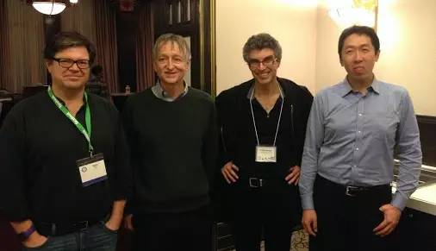
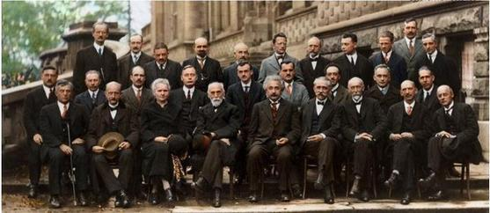
Somehow…

Slide 40
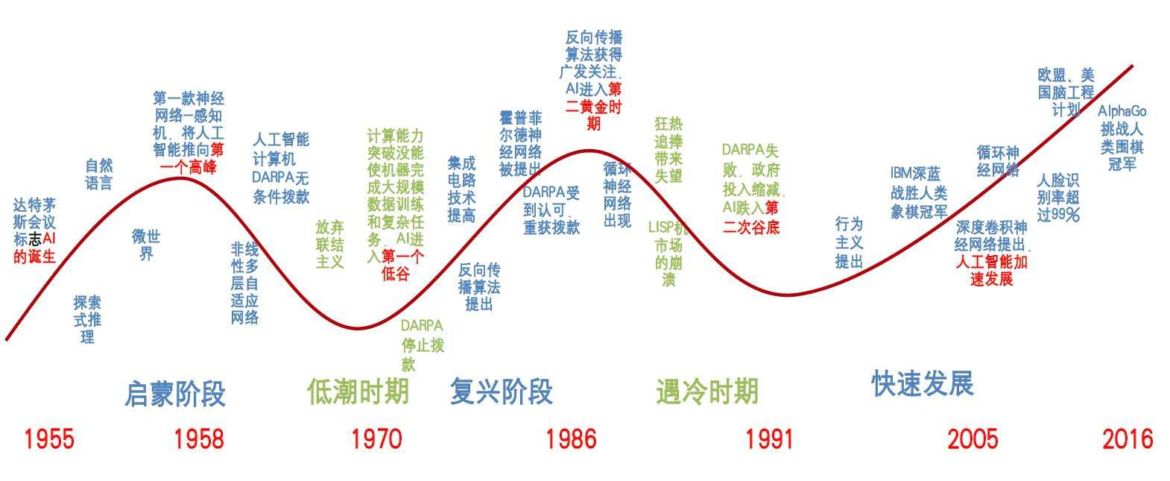
About Deep Learning
History

Slide 41
Part 3
Chapter 2
Review of Linear Algebra

Slide 42
Some interesting staff
P37 linear combination
P42 Eigendecomposition
P48 PCA

Slide 43
Part 4
About Me

Slide 44
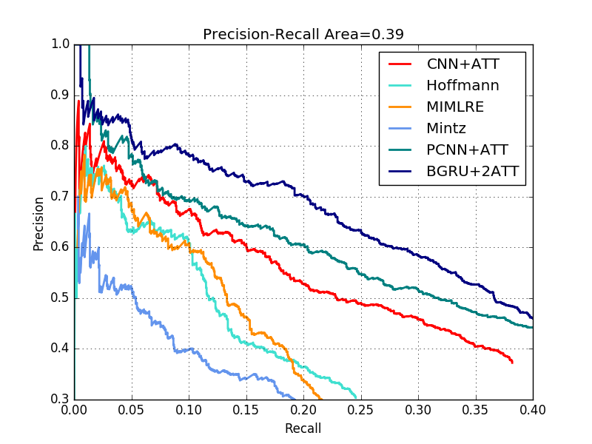
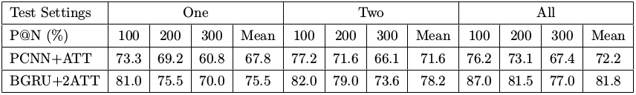
My Research Interests
Relation Extraction, Open Information Extraction

Slide 45
My Research Interests
Pose Detection / Re-identification problem
The intersection of language and vision
One-shot learning

Slide 46


Some thing I like…

Slide 47
The best paper/book that benefits me most…

Slide 48
Something I want to ask…
ResNet/DenseNet .etc. deep net into language ?
Unbalance of training data ?
Overfitting problem of LSTM ?

Slide 49
Part 4
About Seminar

Slide 50
Something we can discuss…
The content we want to hear from the pre ?
How does the pre/organizing/self-supervised work ?
Any suggestion about the improvement of the form ?
The timetable and the split of the whole book ?

Slide 51

THANK YOU！

